Slide 1
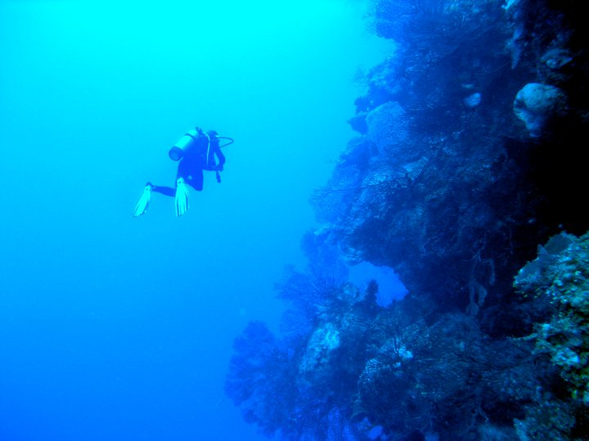
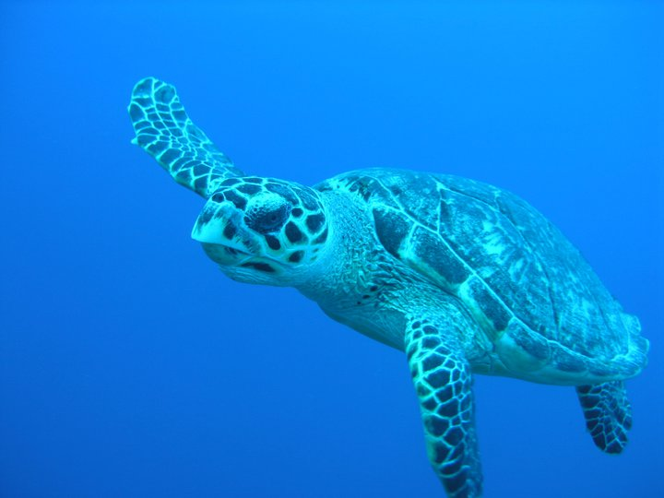
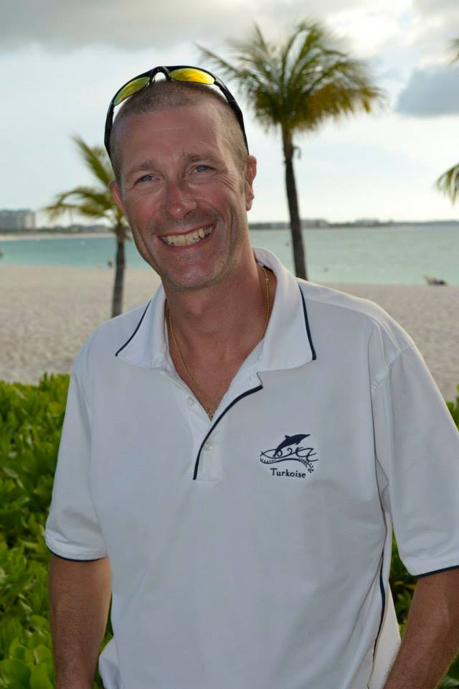
Ricky has been scuba diving since 1989 and is also an accomplished free diver. Ricky has worked internationally with all the best dive operations, giving him the opportunity to dive all the oceans, and almost all the seas, of the world. He is credited with having completed more than 9,000 dives. Ricky’s extensive diving experience has enabled him to develop his own unique coaching methods, working with divers of all levels.
Scuba Diving Referral Program
Students must complete the following steps to receive their PADI Open Water certification - 1) scuba diving theory; 2) pool skills; and 3) four open water dives. The referral program only focuses on the first two steps. Students must then take the referral and complete their training on their warm water vacation. Step 3 does not have to be decided at the time of training, but it must be completed within six months of the training class.
Option #1 |  | $550/per person *
Saturday
8AM – 12PM | Classroom Theory
1PM – 4PM | Pool Skills
Sunday
8AM – 12PM | Pool Skills
1PM – 4PM | Theory Exam
Option #2 |  | $450/per person *
+ Theory e-Learning via padi.com |  | $169/per person
Saturday
9AM – 12PM | Classroom Theory Review
1PM – 4PM | Pool Skills
Sunday
9AM – 1PM | Pool Skills
* Price includes all textbooks and all SCUBA equipment except for mask, snorkel, and fins (all students must supply their own mask, snorkel, and fins). The instructor will provide tanks, regulators, buoyancy compensators, weight belts, and wet suits. If students already own their own equipment, they are encouraged to use it in the pool.
Ricky Lajoie
lajoierichard@gmail.com | 508-745-3943
PADI Staff Instructor #210800  C.M.A.S. 2-Star Instructor #0239

